Slide 1
Sentiment Analysis
An AI/ML Lab project

Slide 2
Intro
What exactly is Sentiment Analysis?
How does it work?
Why use Sentiment Analysis?
Direct correlation to Social Media?

Slide 3
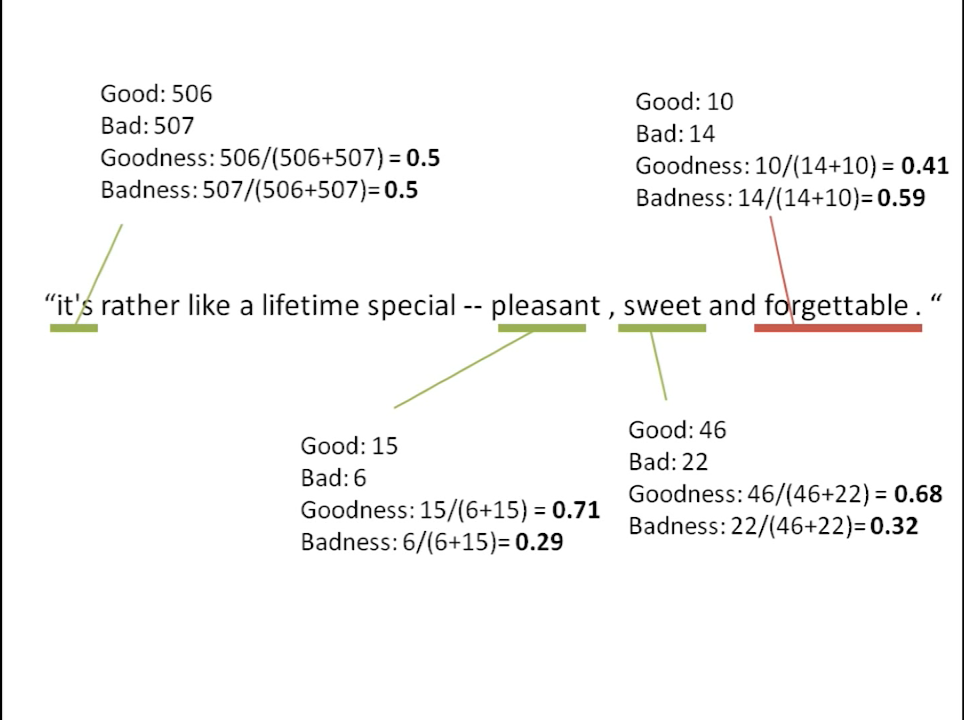
How would an agent recognize a good or a bad statement
A Bag of Words Model
Need Based Classifier

Slide 4
77%
A general sentiment analysis program has an accuracy of 65-86% accuracy

Slide 5
“To do big data well, you need text analytics skills.”
- Michal Smetana, head of marketing of HP in Europe

Slide 6
Sentiment Analysis is not perfect but it can made to learn to be perfect.

Slide 7

Thank You!

